Slide 1



The Reference Model for Disease Progression uses MIST to find data fitness
Jacob Barhak
Austin, Texas
http://sites.google.com/site/jacobbarhak/
PyData Silicon Valley 2014
Facebook Headquarters
Menlo Park, CA
03 May 2014

Slide 2
Disease Modeling - The Very Basics
Disease models:
  Describe phenomena observed in past trials
  Attempt to predict future disease progression
  Used to predict Costs / Quality of Life
Typically developed from a certain population
Current efforts attempt to generalize those models

Slide 3
The Reference Model
Built from literature references and hence the name: The Reference Model
Designed to serve as a reference for new equations and populations
A League / Consumers Report for disease models
Current version deals with diabetic populations
Process CHD
No CHD
MI
Survive MI
CHD Death
Process Stroke
Death
No Stroke
Stroke
Survive Stroke
Stroke Death
Process Competing Mortality
Alive
Other Death

Slide 4
How Does it Work?
Loop through Risk Equation/Hypothesis combinations
Loop through populations
Calculate fitness of simulation outcomes to observed phenomena
1
2
Process CHD
Pop 3
4
3
No CHD
MI
Survive MI
CHD Death
Pop 2
Pop 1
1
2
Process Stroke
Death
No Stroke
4
3
Stroke
Survive Stroke
Stroke Death
Eq 1 | 1 | 1 | 1 | 1 | …
Eq 2 | 1 | 2 | 3 | 4 | …
Pop 1 | 4 | 6 | 2 | 1 | …
Pop 2 | 2 | 4 | 6 | 1 | …
Pop 3 | 2 | 3 | 9 | 2 | …
… | … | … | … | … | …
Process Competing Mortality
Alive
Other Death
Fitness Matrix

Slide 5
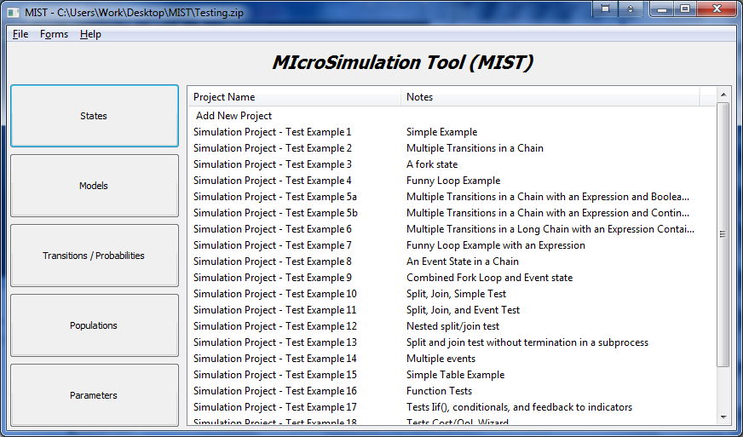
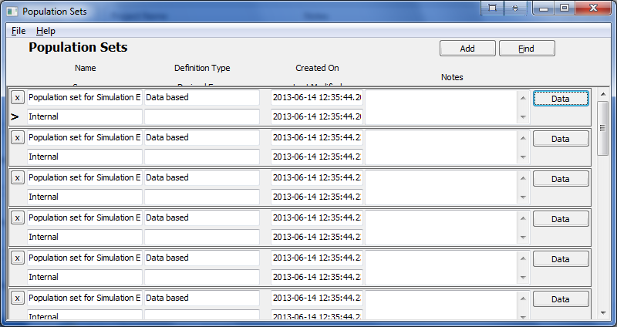
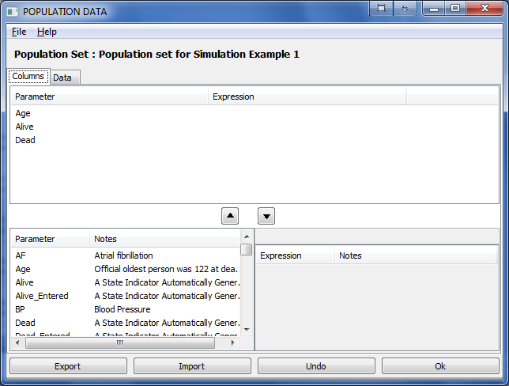
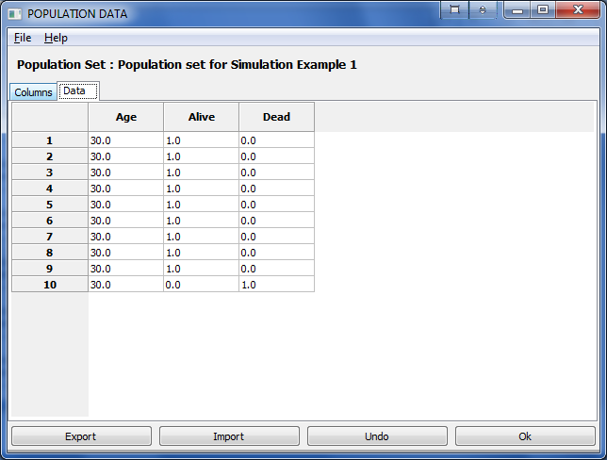
MIST Basics
MIST stands for MIcro-Simulation Tool
  In a nutshell it is a Monte-Carlo simulation compiler
  Offers a Domain Specific Language
  Reproducible simulations
MIST Supports Population Generation
  Generating functions
  Optimization towards objectives
  Evolutionary computation with INSPYRED
MIST runs over the cloud!
  And on Sun Grid Engine (SGE) clusters

Slide 6
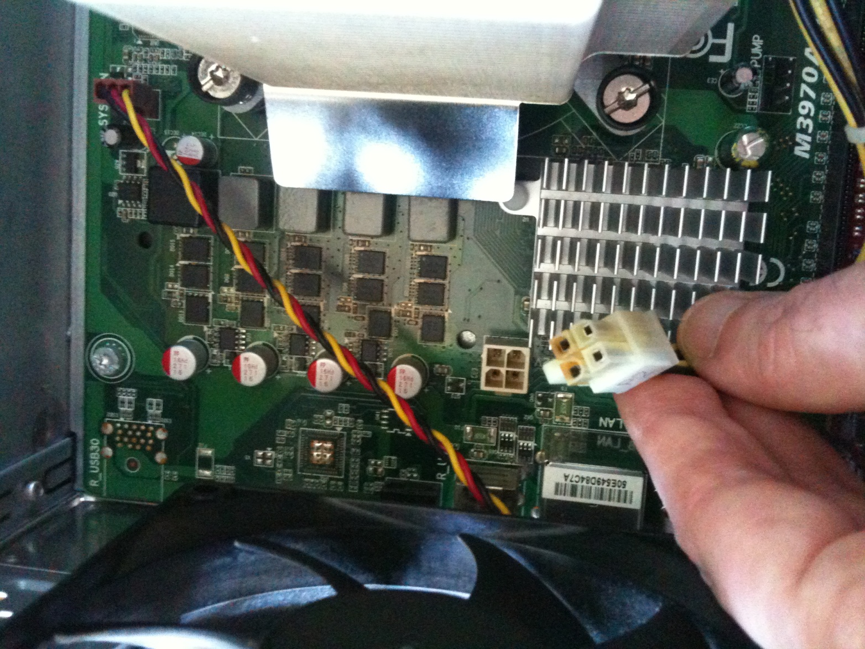
MIST Uses Computing Power
Here is Proof!
Fried after two year of extensive use

Slide 7
MIST Runs Over the Cloud!
Anaconda drives MIST to run over the Amazon cloud!
Batch mode MIST utilities allow:
  Submitting jobs to Sun Grid Engine (SGE)
  Running simulations
  Generating reports
  Combining reports from multiple repetitions/scenarios
Star Cluster creates an SGE cluster on the Amazon Elastic Compute Cloud
The Anaconda Amazon Machine Image (AMI) is used for the cluster master / nodes
Good for:
  Cutting down computation time by renting computing power
  Saving initial and maintenance costs associated with a cluster
MIST
Cloud

Slide 8
Populations: Background
The First Table in a Clinical Trial publication typically contains Population Statistics
  Summary Data Only: Mean (SD) / Median (IQR)
  Limited information about distribution
  Inclusion/exclusion criteria skew the distribution
Example: Excerpt from Table 1 in UKPDS 33
 | Control | Intervention
Age | 53.3 (8.6) | 53.2 (8.6)
% Male | 61.9% | 59.3%
Smoke | 31% | 30%
Systolic Blood Pressure (mmHg) | 135(20) | 135(20)
Total Cholesterol (mmol/L) | 5.4 (1.02) | 5.4(1.12)

Slide 9
INSPYRED MIST
INSPYRED MIST can regenerate mock populations from Table 1 in clinical trials
Only publicly available summary data is used
No need to have access to restricted data
INSPYRED
Table 1
MIST
Generate

Slide 10


MIST uses INSPYRED
Bio Inspired computation Python library
  Evolutionary Computation
  Swarm Intelligence
  Neural Networks
Developed and Maintained by Aaron Garrett
Repository: https://github.com/inspyred/inspyred

Slide 11
INSPYRED Evolutionary Computation:
Population Generation & Objectives
Generation Expressions:
  Define how to generate a single individual
  Test if individual fits the inclusion/exclusion criteria
  Define ties and correlations between characteristics
Objectives:
  Define aggregate targets for the entire population
  Reduce random generation error
  Handle skewed distributions to fit target
INSPYRED
MIST
Expression Compiler
Evolutionary Computation
Monte Carlo
Selection
Result
Result Population
Converges to
Objectives

Slide 12
INSPYRED Evolutionary Computation
Candidates
Generator
Evaluator
3.1
7.5
4.2
5.2
Selector
+
=
→
Generations / Epocs
Variators
Repeat
Parents
Crossover
Mutation
Terminator
Best Solution

Slide 13
Population Generation Example
Skewed by Inclusion/Exclusion
Generate 10 people with:
  Inclusion criteria is 45< Age <90
  The base population distribution is:
    Age for Male: Mean 53 SD 10
    Age for Female: Mean 52 SD 7
    Male: 50%
Generation Functions (Implementation):
  Age ~ Iif (Male,Gaussian(53,10) ,Gaussian(52,7))
  Male ~ Bernoulli(0.5)
  Assert = And(Gr(Age,45),Ls(Age,90))
Notes:
  May not represent well what was intended
  Assertion drops non qualifying candidates
  The resulting Age is skewed
Age | Male
48.85785535 | 0
59.94741744 | 0
56.19039096 | 1
64.40825341 | 0
49.77582796 | 1
60.29975596 | 1
51.27571792 | 1
72.13820388 | 1
55.51746037 | 0
58.72574003 | 0
Design is Subject to Constraints
Final population that would have been reported in Table 1:
Age Mean: 57.71366233
Age SD: 7.115024093
Male Mean: 0.5
Result to be Published

Slide 14
Population Generation Example
With Objectives & INSPYRED
Generate 10 people with objectives:
  Base distribution & Inclusion criteria as before
  Age : Mean 50, SD 5
  Male: 60%
Objectives (Implementation):
  Age Mean: 50 , Weight 1
  Age SD: 5 , Weight 1
  Male: 0.6 , Weight 10
Notes:
  Design matches results as much as possible
  The designer can study effect of constraints
  Table 1 can now be planned ahead!
Age | Male
50.8953429 | 0
53.71135174 | 1
52.86278825 | 0
46.021901 | 1
48.36662032 | 1
47.87355499 | 1
45.11370607 | 1
62.15347882 | 1
47.48350736 | 0
45.93131347 | 0
Design = Desired + Constraints
Final population selected out of 1000 generated candidates:
Age Mean: 50.04135649
Age SD: 5.166548964
Male Mean: 0.6
Result to be Published

Slide 15
The Reference Model Fitness Matrix
Raw Models
BioMarker Correction
Biomarkers Independent
Fully Correlated
Unexplained
8 Populations = 40 cohorts x 2
Biomarkers Independent
Best Model
Fully Correlated
Date Correction
Date+BioMarker Correction
50 Models x 4 Assumptions
Version 22 - MIST_RefModel_2014_04_29_MATRIX_TraceBack.zip

Slide 16
This Modeling Technology Opens Possibilities
The Reference Model for Disease Progression
  Participating in the Mount Hood Challenge 2014
  Non diabetic populations?
Population Generation - Unexplored Potential:
  Planning Recruitment Efforts?
    Clinical Trials?
    Other Recruitment Efforts?
  Other population modeling?

Slide 17
Acknowledgments
Deanna J.M. Isaman - who is the spirit behind the great ideas. She taught me my first steps in disease modeling
Morton Brown & William H. Herman – for guidance, critical feedback, and growth environment
Aaron Garrett – for his responsiveness and help with starting with Inspyred – he saved me at least a months work if not two by sending me solution code within one day.
Continuum Analytics and specifically:
  Benjamin Zeitler for creating the cloud AMI
  Ilan Schnell for his work on Anaconda.
All those who developed free software used and supported it: including Python, Anaconda, Spyder, numpy, SciPy, nose, winpdb, Star Cluster, Ubuntu, Sun Grid Engine
The legacy IEST modeling framework was supported by the Biostatistics and Economic Modeling Core of the MDRTC (P60DK020572) and by the Methods and Measurement Core of the MCDTR (P30DK092926), both funded by the National Institute of Diabetes and Digestive and Kidney Diseases. The modeling framework was initially defined as GPL and was funded by Chronic Disease Modeling for Clinical Research Innovations grant (R21DK075077) from the same institute. MIST is based on IEST.
The Reference Model and MIST were developed independently without financial support

Slide 18

Questions?
MIST Jacob Barhak
  https://github.com/Jacob-Barhak/MIST
  http://sites.google.com/site/jacobbarhak/

Slide 19
Risk Equations from the Literature Blinded
A1c, ACR, AF, Age, AgeAtDiagnosisOfDiabetes, BMI, DBP, DiabetesType2, FamilyHistoryCHD, HDL, LDL, LipidRatio, MacroAlbuminuria, Male, MicroAlbuminuria, Race, RheumatoidArthritis , SBP, Smoke, Survive_MI, Survive_Stroke, TC, Townsend, TreatedHypertension
Bio-Markers / Parameters
 | 1 | 2 | 3 | 4 | 5 | 6 | 7 | 8 | 9 | 10 | 11 | 12 | 13 | 14 | 15 | 16 | 17 | 18 | 19 | 20 | 21 | 22 | 23 | 24
1 | * |  |  | * | * |  |  | * | * | * | * |  | *
2 | * |  | * | * | * | * |  | * |  | * | * |  | * |  |  |  |  | * | * | * | *
3 |  |  |  | * |  |  | * |  |  |  | * | * | * |  | * | *
4 |  |  | * | * |  | * | * | * | * |  | * |  | * | * |  |  |  |  | * |  |  | * | * | *
5 |  |  | * |  | * |  |  | * |  | * | * |  | *
6 | * |  | * |  | * |  |  | * |  | * | * |  | * |  | *
7 | * | * |  | * |  |  |  |  |  |  |  |  |  |  |  |  |  |  |  | *
8 | * |  |  | * | * |  |  |  |  |  |  |  | *
9 |  |  |  |  |  |  |  |  |  |  |  |  | * |  |  |  |  |  |  |  | *
Risk Equations
Smoke

Slide 20
The Reference Model for Disease Progression
Simple - Low Resolution
Based on secondary data:
  Published Risk Equations
  Published Clinical Trials, i.e. no real individual data
  Other publications
Relies on computing power/techniques
  Parallel processing / High Performance Computing
  Competition among alternative equation/hypothesis combinations
  Cross validation - One click validation
  Ranks results according to fitness - Fitness Engine
  Accumulates knowledge

Slide 21
INSPYRED Evolutionary Computation
INSPYRED elements provided by MIST:
  Evaluator: Score a specific sub-population = Fitness function
  Generator: Generates a sub-population from candidate population
  Random generator: Control random numbers: Allows Reproducibility
  Variators:
    Cross Over: method to create a sub populations from two others
    Mutation: Method to change a sub-population
  Terminators:
    Max Eval: stop when computation is too long
    Max Stable: Stop when result Is stable
  Additional parameters: Population Size, Sub-population Size, etc.
  Selector: Standard INSPYRED Tournament
  Observer: Standard INSPYRED statistic observer

Slide 22
Simulation Language / Compiler
Strict Expression language – a subset of Python with extensions:
  Supported Types: Integer, Number, Expression, State Indicator, System Option
  Comparison: Eq, Ne, Gr, Ge, Ls, Le
  Boolean operators: Or, And, Not, IsTrue
  Special math: Inf, NaN, IsInvalidNumber, IsInfiniteNumber, IsFiniteNumber
  Mathematical functions: Exp, Log, Ln, Log10, Pow, Sqrt, Pi
  Other functions: Mod, Abs, Floor, Ceil, Max, Min
  Statistical: Bernoulli, Binomial, Geometric, Uniform, Gaussian
  Control and Data Access: Iif, Table
  Application specific: CostWizard
Features:
  Compiles into Python
  Syntax check upon expression definition
  Runtime Bound Checks
  Runtime recalculation due to out of bounds random error
MIST
Model/ Population
Python Script
Compile
Run
Results

Slide 23
Monte Carlo Initialization:
Distribution to Population Generation
The system:
  Compiles distributions into initialization code before simulation
  Automatically resolves calculation order
  Can handle interdependencies
  Evolutionary Computation towards user defined objectives
Example with no objectives:
  Age ~ 61+8.2*CappedGaussian3
  Male ~ Bernoulli(803/1199)
  SBP ~ 133.4+16.4*CappedGaussian3
  AgeAtDiagnosisOfDiabetes ~ Age - 8
Good for:
  Using published aggregate data from clinical trial publications
  Avoiding using individual data that is typically restricted
  Allowing access to more population information
Age | Male | SBP | AgeAtDiagnosisOfDiabetes
65.51415 | 1 | 129.1721 | 57.51415
53.76856 | 1 | 137.4234 | 45.76856
73.71445 | 0 | 132.8542 | 65.71445
45.79667 | 1 | 147.5537 | 37.79667
57.21742 | 1 | 122.68 | 49.21742

Slide 24
Monte Carlo Simulation
Pop
  If random < OccurrenceProbability:
  AffectedParameter = DefinedExpression
  If random < OccurrenceProbability:
  AffectedParameter = DefinedExpression
Init
Rules
Mutli-Process State Transitions
Process
CHD
No CHD
MI
Survive MI
CHD Death
Pre
State Transition Rules
Process
Stroke
Post
State Transition Rules
Death
No Stroke
Stroke
Survive Stroke
Stroke Death
Process
Competing Mortality
Alive
Other Death
Cost QoL
Biomarkers
Repeat Simulation Step

Slide 25
Reproducibility
MIST stores random state of each simulation
MIST can recreate a simulation from Trace Back upon request
MIST records additional traceability information in compiled simulation files to help debugging
Good For:
  Saving storage space
  Debugging
  Distributing results & publication

