Slide 1
The Reference Model Estimates Medical Practice Improvement In Diabetic Populations
Jacob Barhak
Austin, Texas
SpringSim 2017
April 23 –26, 2017 Virginia Beach, Virginia, USA

Slide 2
Disease Models at a Glance
Which behave better?
Describe clinical phenomenon observed in past studies
  e.g. heart attacks, strokes, mortality, transplants
Attempt to predict future disease progression
Disease models apply a function to an initial cohort
  Markov model
  Differential equation
  Hybrid functions
How to merge this knowledge?
Normal
Sick
Dead
Are models up to date?

Slide 3
Temporal Medical Improvement
Healthcare quality improved through the years.
  M.L. Weisfeldt, S.J. Zieman. Advances In The Prevention And Treatment Of Cardiovascular Disease. Health Affairs, 26, no.1 (2007):25-37. DOI: 10.1377/hlthaff.26.1.25
    Shows improvement trend
    Lists procedures and drugs on a timeline since 1970
  E.W. Gregg , Y.J. Cheng , S. Saydah , C. Cowie , S. Garfield , L. Geiss , L. Barker, Trends in death rates among U.S. adults with and without diabetes between 1997 and 2006: findings from the National Health Interview Survey. Diabetes Care. 2012 Jun;35(6):1252-7. DOI: 10.2337/dc11-1162
    Quantifies improvement between NHANES cohorts
    Diabetic CVD death 2003–2004 vs. 1997–1998, Hazard Rate Ratio: 0.60
This work recalculates it using multiple models and data sources over several decades
This 6 year coefficient was initially used

Slide 4
The Reference Model for Disease Progression
CHD = Coronary Heart Disease
MI = Myocardial Infarction
Contains Validation Errors
Model Results – Clinical Trial Results
Built from literature references and hence the name: The Reference Model
Compares equation performance on multiple clinical studies using High Performance Computing
Consumers report emulation for disease models
Current version deals with diabetic populations
A
B
Process CHD
Pop 3
D
C
No CHD
MI
Survive MI
CHD Death
Eq EH | E | E | E | E | …
Eq AD | A | B | C | D | …
Pop 1 | 4 | 6 | 2 | 1 | …
Pop 2 | 2 | 4 | 6 | 1 | …
Pop 3 | 2 | 3 | 9 | 2 | …
… | … | … | … | … | …
Pop 2
Pop 1
E
F
Process Stroke
Death
No Stroke
H
G
Stroke
Survive Stroke
Stroke Death
Fitness Matrix
`
Process Competing Mortality
Alive
Other Death

Slide 5
Results 2014
Raw Models
BioMarker Correction
Biomarkers Independent
Fully Correlated
Unexplained
8 Populations = 40 cohorts x 2
Biomarkers Independent
Best Model
Fully Correlated
Date Correction
Date+BioMarker Correction
50 Models x 4 Assumptions
Version 22 - MIST_RefModel_2014_04_29_MATRIX_TraceBack.zip

Slide 6
Temporal Medical Improvement Hypothesis
The 0.6 HRR was translated to yearly probability decrease for: MI , Stroke, MI Death, Stroke Death
This probability was adjusted for time passed between:
  Model year = average of Model Data Time Interval
  Simulated Time Stamp = simulated study year/s
This correction term accounts for model outdate
Model Data Time Interval
Simulated
Time Stamp
Time
Adjustment Time

Slide 7
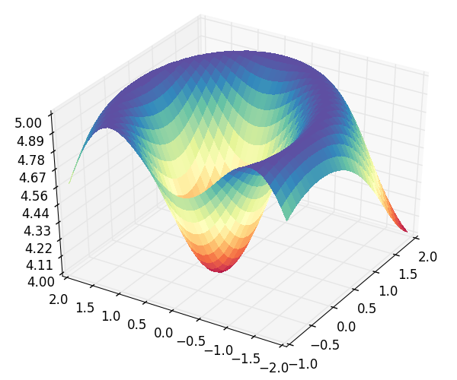
From Competition to Cooperation
Eq EH | E | E | E | E | …
Eq AD | A | B | C | D | …
Pop 1 | 4 | 6 | 2 | 1 | …
Pop 2 | 2 | 4 | 6 | 1 | …
Pop 3 | 2 | 3 | 9 | 2 | …
… | … | … | … | … | …
A
B
Process CHD
aA+bB+cC+dD
Pop 3
Linear combination rather than one risk equations
Ensemble model where models cooperate
Fitness in continuous space rather than discrete space
Reduce computation time for best fitting model
Best model more accurate
No CHD
D
C
MI
Survive MI
CHD Death
Pop 2
Pop 1
E
F
eE+fF+gG+hH
Process Stroke
Death
Discrete Fitness Matrix
No Stroke
H
G
Stroke
Survive Stroke
Stroke Death
Process Competing Mortality
Alive
Other Death
Continuous Fitness Space

Slide 8
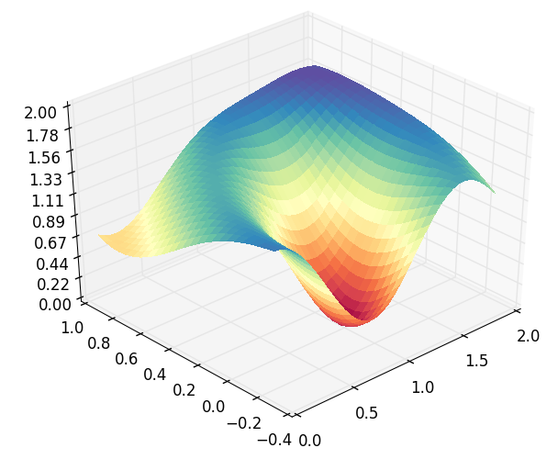
The Assumption Engine
The Assumption Engine allows us to “throw” assumptions at it
  A model is an assumption!
It figures out which assumptions work well together to fit observed data
  Points to significant models
  Rejects incompatible models
Fitness (s)
Equation Coefficient (t₂=b)
Equation Coefficient (t₁=a)

Slide 9
Temporal Medical Improvement Calculated
Data and model from 3 decades
Multiple models were used with model stamps ranging from 1978.5 to 2007.05
Validated against 9 populations included in the period ranging from 1977 to 2010
The assumption engine was asked to calculate the best fit:
  Significance of each model used
  The yearly improvement coefficient
  The prevention coefficient = indicating if improvement is pre event or post event
This correction term accounts for model outdate
Model Data Time Interval
Simulated
Time Stamp
Time
Adjustment Time

Slide 10
The Assumption Engine Results
Dominant equations
Rejected equation
Dominant equations
Dominant equations
Dominant equations
Minor
difference
MI
Stroke
Other
Death
MI
Death
Temporal Correction Better Fits Data
Stroke
Death
Temporal
Improvement
Reproducibility Info:
MIST_RefModel_2016_10_26_OPTIMIZE.zip using model version 44
MIST_RefModel_2016_12_17_OPTIMIZE.zip using model version 45

Slide 11
Results Summary
Halved every 5 years
Yearly Temporal Correction CVD Coefficient η=0.86/0.87 from 1978.5 to 2007.05
  Transformed For 6 years = 0.41/0.44
  Gregg et. al. reports 0.6 (0.46 - 0.77) for 2003–2004 vs. 1997–1998
The Prevention coefficient ϕ=0.43/0.53
Slightly better than Gregg et. al.
Still within similar range
Is medical improvement rate slowing down?
Similar improvement of prevention and post event treatment

Slide 12
How Reliable Are These Results?
Probably stable enough - enough data was accumulated
Noise
  Data
  Monte Carlo
Data
  9 populations
  Are models representative?
  Missing data – estimated dates
Human Error
  These results do contain human entry error
Model Assumptions
  Improvement rate Formulation
  Ensemble model formulation
Optimization
  Multiple possible solutions
  Arbitrary stopping criteria
Similar results reported in the past so probably not far from the truth

Slide 13
Conclusions
We can calculate how fast
Medical practice is improving fast!
New disease models should include temporal correction for medicine improving
  Especially when estimating long term phenomena such as life expectancy
The Reference Model accumulates knowledge towards a wider view
  It can now extract such data from ClinicalTrials.Gov

Slide 14
Acknowledgments
Deanna J.M. Isaman - who is the spirit behind the great ideas. She taught me my first steps in disease modeling
Morton Brown & William H. Herman – for guidance, critical feedback, and growth environment
Nicke Ide and the NIH program officers that connected me to him to allow creating the interface with ClinicalTrials.Gov
Continuum Analytics and specifically:
  Benjamin Zeitler for creating the cloud AMI
  Ilan Schnell for his work on Anaconda.
All those who developed free software used and supported it: including Python, Anaconda, Spyder, numpy, SciPy, nose, winpdb, Star Cluster, Ubuntu, Sun Grid Engine
The legacy IEST modeling framework was supported by the Biostatistics and Economic Modeling Core of the MDRTC (P60DK020572) and by the Methods and Measurement Core of the MCDTR (P30DK092926), both funded by the National Institute of Diabetes and Digestive and Kidney Diseases. The modeling framework was initially defined as GPL and was funded by Chronic Disease Modeling for Clinical Research Innovations grant (R21DK075077) from the same institute. MIST is based on IEST.
The Reference Model and MIST were developed independently without financial support

Slide 15

Questions?
Jacob Barhak
  http://sites.google.com/site/jacobbarhak/

Slide 16
Temporal Medical Improvement Hypothesis
The 0.6 HRR was translated to yearly probability decrease for: MI , Stroke, MI Death, Stroke Death
This probability was adjusted for time passed between:
  Model year = average of Model Data Time Interval
  Simulated Time Stamp = simulated study year/s
This correction term accounts for model outdate
Model Data Time Interval
Simulated
Time Stamp
Time
Adjustment Time

Slide 17
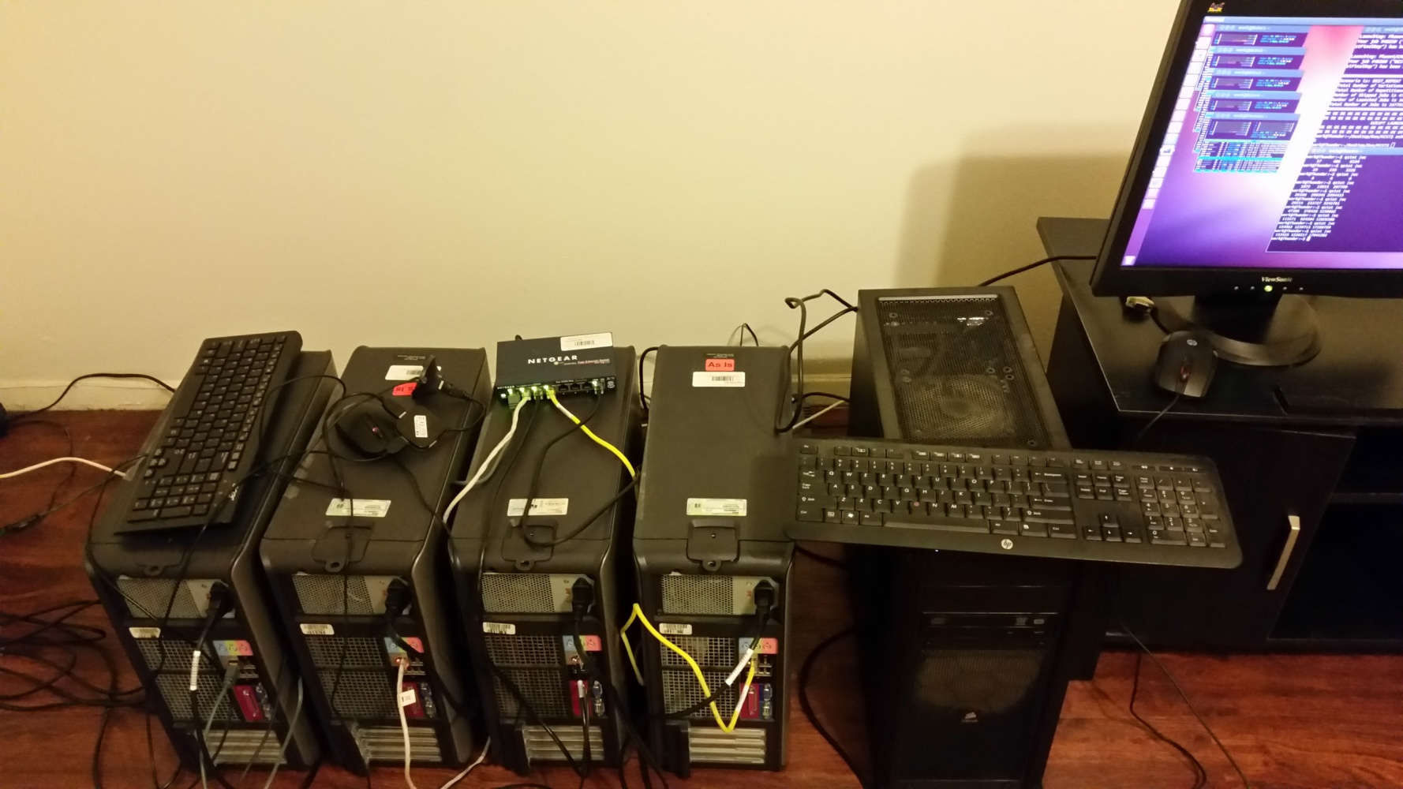
The Reference Model is Powered by MIST
MIST = MIcro Simulation Tool
Free Software:
  https://simtk.org/projects/mist
  https://github.com/Jacob-Barhak/MIST
Uses High Performance Computing
MIST Runs over the Cloud !!!
MIST
Cloud

Slide 18
Historical Evolution
2012 – Start
2013 – High Performance Computing and Cloud Computing
2014 – Evolutionary Computation for Population Generation
2015 – Object Oriented Population Generation
Estimated 3 month computation using 16 CPU cores
2016: Computational Wall Reached

